Slide 1


Ankita Das
18 June 2024

Slide 2

Outline
Executive Summary
Introduction
Methodology
Results
Conclusion
Appendix

Slide 3
Executive Summary
Summary of methodologies
Data Collection
Data Wrangling
Exploratory Data Analysis
Machine Learning & Prediction
Summary of all results
EDA findings
Predictions

Slide 4
Introduction
Project background and context
Machine Learning to predict if first stage will land successfully
Problems you want to find answers
Factors that determine success rate
Conditions for success

Slide 5

Section 1

Slide 6
Methodology
Executive Summary
Data collection methodology:
Data used was accessed through web scraping from SpaceX API
Perform data wrangling
Categorical Features were encoded
Perform exploratory data analysis (EDA) using visualization and SQL
Perform interactive visual analytics using Folium and Plotly Dash
Perform predictive analysis using classification models

Slide 7
Data Collection
Datasets were collected.
Data was cleaned and handled where required for missing values
Source | Link
SpaceX API data | https://api.spacexdata.com
Wiki data | https://en.wikipedia.org/w/index.php?title=List_of_Falcon_9_and_Falcon_Heavy_launches&oldid=1027686922

Slide 8
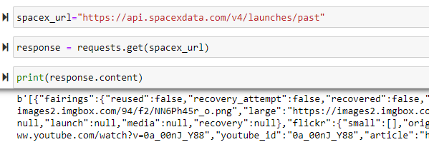
Data Collection – SpaceX API
Present your data collection with SpaceX REST calls using key phrases and flowcharts

Slide 9
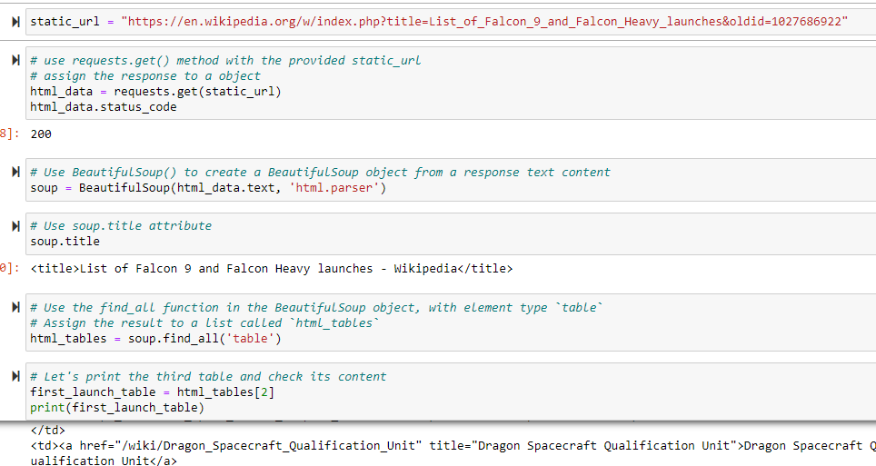
Data Collection - Scraping
Present your web scraping process using key phrases and flowcharts

Slide 10
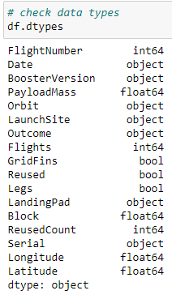
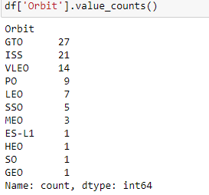
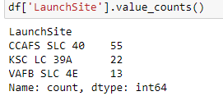
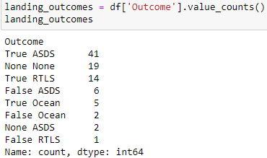
Data Wrangling
Data types were checked
Data checked for nulls
Launch site value_counts were checked
Orbit value_counts were checked
Landing outcomes were checked

Slide 11
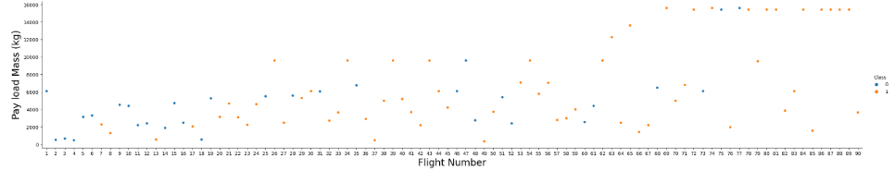
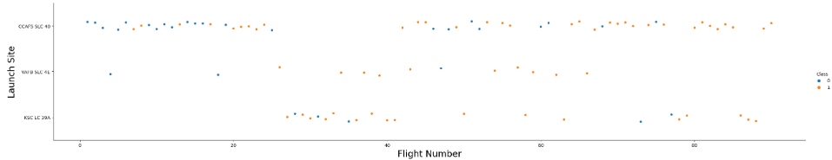
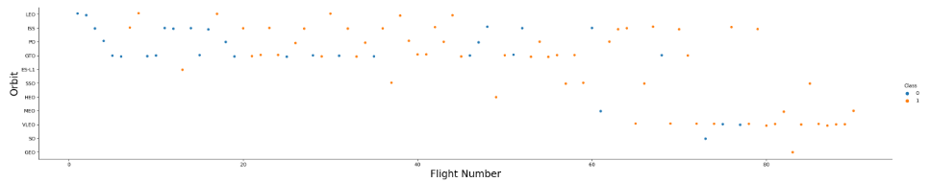
EDA with Data Visualization
Payload, launch site, orbit type for flights checked

Slide 12

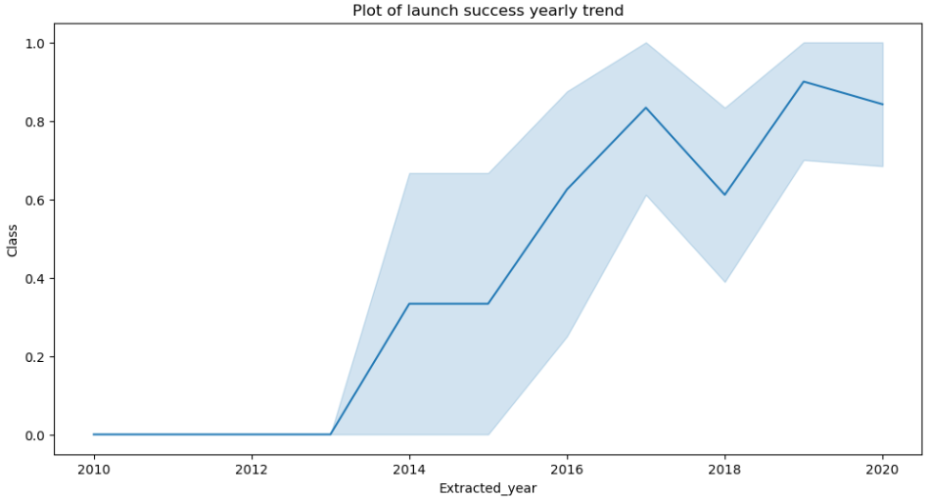
EDA with Data Visualization
Success rate by orbit, year

Slide 13
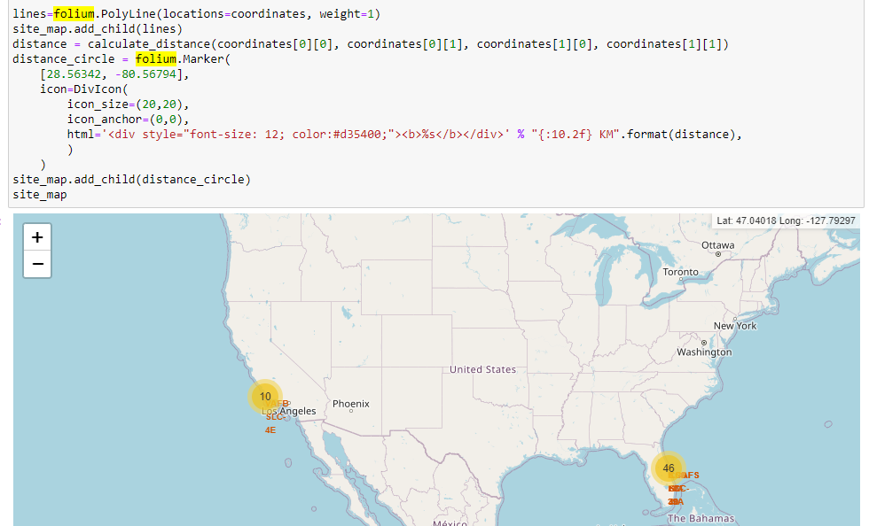
Build an Interactive Map with Folium
Elements accessible
Railway
Highway
City
Distance

Slide 14
Predictive Analysis (Classification)
SVM result checked
Decision Tree result checked
KNN result checked
Decision Tree found to have best performance

Slide 15
Results
Exploratory data analysis results generated
Interactive analytics results generated
Predictive analysis results generated

Slide 16

Section 2

Slide 17
Flight Number vs. Launch Site
The SLC 40 launch site has the most number of launches compared to the rest

Slide 18
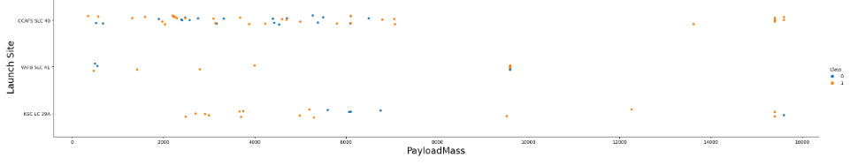
Payload vs. Launch Site

Slide 19
Success Rate vs. Orbit Type

Slide 20
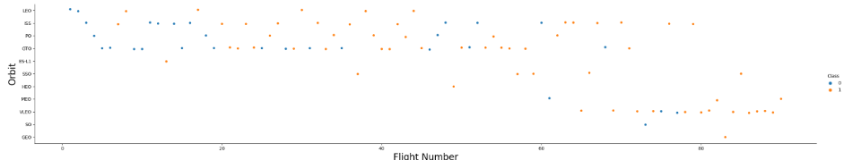
Flight Number vs. Orbit Type

Slide 21
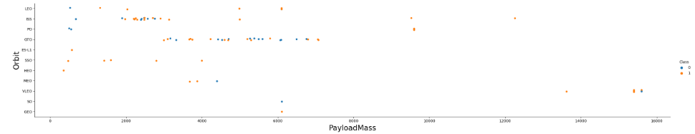
Payload vs. Orbit Type

Slide 22
Launch Success Yearly Trend

Slide 23
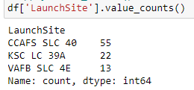
All Launch Site Names

Slide 24
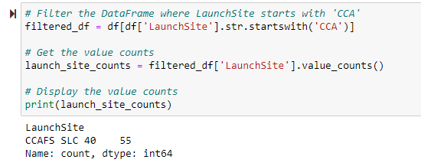
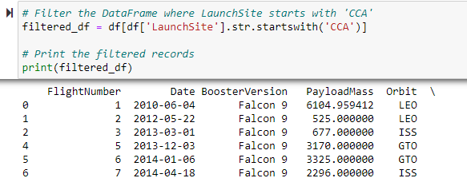
Launch Site Names Begin with 'CCA'
SELECT * FROM SpaceX
WHERE LAUNCHSITE LIKE ‘CCA’
LIMIT 5

Slide 25
Total Payload Mass
SELECT SUM(PayloadMassKG) AS Total_PayloadMass
FROM SpaceX

Slide 26
Average Payload Mass by F9 v1.1
SELECT AVG(PayloadMassKG) AS Avg_PayloadMass
FROM SpaceX
WHERE BoosterVersion = ‘F9 v1.1’

Slide 27
First Successful Ground Landing Date
SELECT MIN(Date) AS FirstSuccessfull_landing_date
FROM SpaceX
WHERE LandingOutcome LIKE ‘Success (ground pad)’

Slide 28
Successful Drone Ship Landing with Payload between 4000 and 6000
SELECT BoosterVersion
FROM SpaceX
WHERE LandingOutcome = ‘Success (drone ship)’
AND PayloadMassKG > 4000
AND PayloadMassKG < 6000

Slide 29
Total Number of Successful and Failure Mission Outcomes
SELCT COUNT(MissionOutcome) AS SuccessOutcome
FROM SpaceX
Where MissionOutcome LIKE ‘Success%’
SELCT COUNT(MissionOutcome) AS SuccessOutcome
FROM SpaceX
Where MissionOutcome LIKE ‘Failure%’

Slide 30
Boosters Carried Maximum Payload
SELECT BoosterVersion, PayloadMassKG
FROM SpaceX
WHERE PayloadMassKG = ( SELECT MAX(PayloadMassKG) FROM SpaceX )
ORDER BY BoosterVersion

Slide 31
2015 Launch Records
SELECT BoosterVersion, LaunchSite, LandingOutcome
FROM SpaceX
WHERE Date BETWEEN ‘2015-01-01’ AND ‘2015-12-31’

Slide 32
Rank Landing Outcomes Between 2010-06-04 and 2017-03-20
Landing outcome “No attempt” was the highest
SELECT LandingOutcome , count(LandingOutcome)
FROM SpaceX
WHERE Date BETWEEN ‘2010-06-04’ AND ‘2017-03-20’
GROUP BY LandingOutcome
ORDER BY COUNT(LandingOutcome) DESC

Slide 33

Section 3

Slide 34
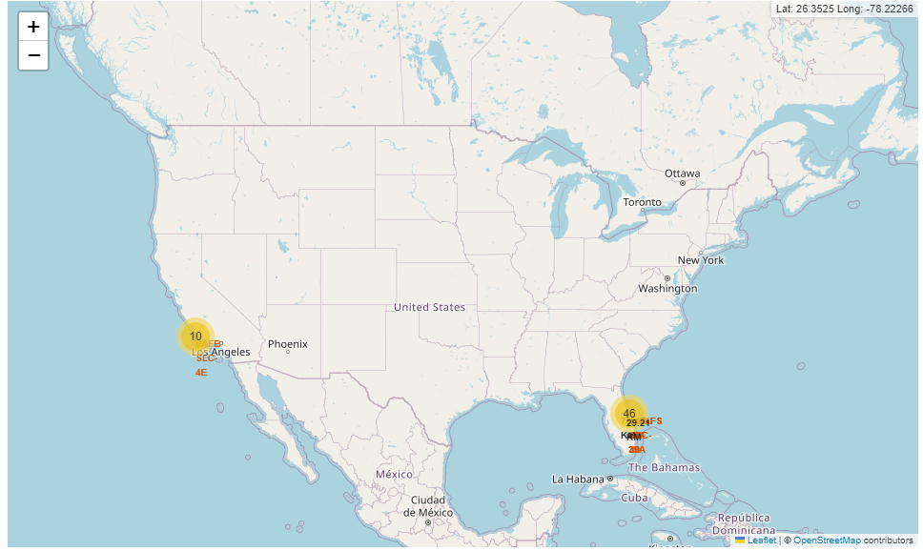
Folium Map Screenshot

Slide 35
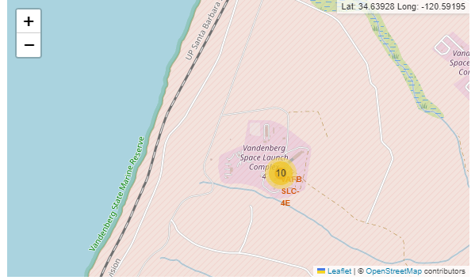
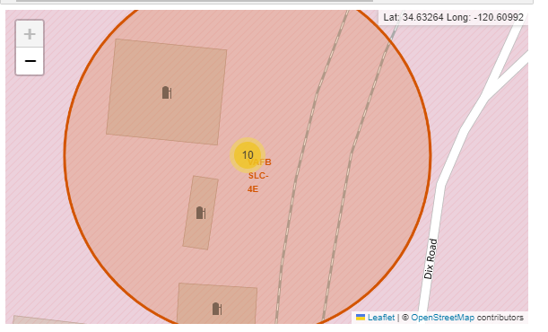
Folium Map Screenshot

Slide 36

Section 4

Slide 37
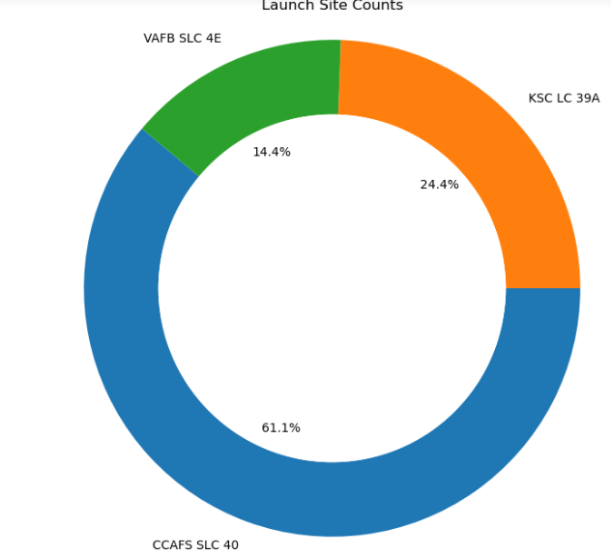
Launch Site

Slide 38

Section 5

Slide 39
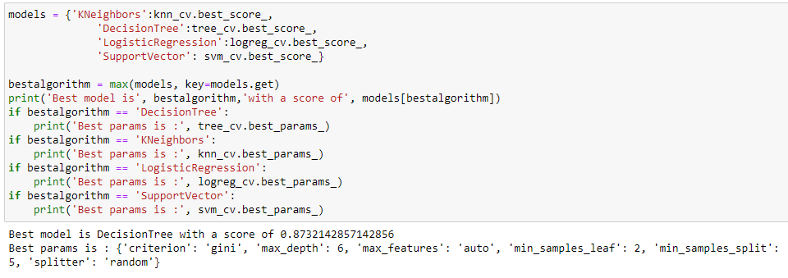
Classification Accuracy

Slide 40
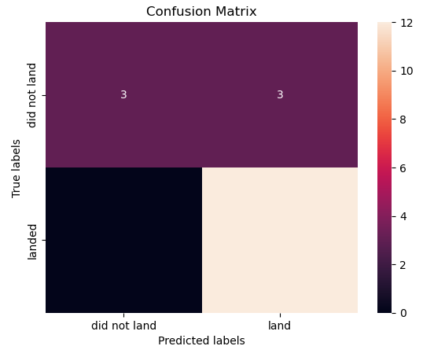
Confusion Matrix

Slide 41
Conclusions
Point 1
Point 2
Point 3
Point 4
…

Slide 42


